Slide 1
Multiplatform automated software testing: personal experience
Maxim Mozgovoy
The University of Aizu
mozgovoy@u-aizu.ac.jp

Slide 2
Hello!
I live & work at Aizu, Japan.
My primary area is human-like AI for computer games and simulations.
Basically, “AI that needs to possess other qualities rather than just being good”

Slide 3
Hello!
As a professor, currently I supervise 18 students (mostly undergrads).
Also I have strong interest in practical software development and previous industrial experience

Slide 4
My friend’s idea
Your AI
Our people
Great game
Get rich

Slide 5
We made it (to some extent!)
A cool casual tennis game
Released on Win, Mac, Android, and iOS
Around 1mln downloads
Really good reviews
Released later than hoped
Profits aren’t stellar yet

Slide 6
Nothing works better than just improving your product. — Joel Spolsky

Slide 7
What’s special about game projects?
Frequent complaints | %
Functional error | 26.68
Feature request | 15.13
App crash | 10.51
Network problem | 7.39
Users won’t tolerate bugs [1]
Negative reviews & crashes cause downranking [2]
Low-rank apps have no chance on the market

Slide 8
What’s special about game projects?
They are quite complex (really):
Frontend/backend.
User analytics.
Billing/transactions.
Integration with numerous 3rd-party systems (social media, advertisements, online profiles)

Slide 9
What’s special about game projects?
They rely on (unstable) 3rd-party libraries and tools
They have to be updated regularly

Slide 10
What’s special about game projects?
They must run on diverse hardware and software platforms
They are prone to issues that are hard to test automatically (graphics, sound, animation)
GUI and animation is deeply integrated into a game

Slide 11
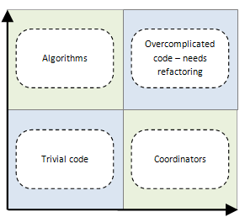
What’s special about game projects?
They contain a large proportion of code with high cost of unit testing [3]
unit testing benefits
unit testing costs

Slide 12
Our approach
Primary emphasis on extensive testing of the complete game
Synergy of diverse tools

Slide 13
Tool #1: Firebase Crashlytics
Embed Crashlytics reporting service into the app
Crashes are automatically reported to us via Internet (along with stack traces)
Identified devices with insufficient RAM for the game

Slide 14
Tool #2: Autobugs and Manual Bugs
Use soft (reporting) asserts and manual reporting tools
Report failed non-fatal asserts automatically. Give the users and testers tools to report easily.
Got numerous bug reports (wrong physics, animation, GUI flaws, etc.)

Slide 15
Tool #3: Automated smoke testing (autotests)
Ensures that the most important subsystems work
by preforming various simple test scenarios
The most cost effective method for identifying and fixing defects in software [after code reviews]
— Microsoft
“

Slide 16
Our smoke tests
We invested a lot of effort into building our own smoke-testing facilities, and now we find them essential for subsequent planned projects

Slide 17
Our pipeline
Build machine (several builds daily)
Ready game (5 platforms)
Repository

Slide 18
Basic levels of QA
The game can be compiled (ensured by the build machine).
The game doesn’t crash on startup (it might due to fatal bugs or incorrect partial build)
The game can connect to our backend server.
Early detection is crucial: we need to know which changeset in our repo causes problems.

Slide 19
Let’s just test that the game doesn’t crash and is able to go online — Our project manager

Slide 20
One year later
Every build goes through six test scenarios; each scenario takes 30-60 min to complete

Slide 21
Points to consider
The game has no “hidden interface”: the testing system relies on the ordinary user-end UI.
Note the synergy: automated tests also generate autobugs and crash events, detectable by our other tools!
Autotests are run on three Android, three iOS and one Windows devices (macOS is planned).
Autotests also report FPS and memory consumption; They can be run for several hours as stress tests.

Slide 22
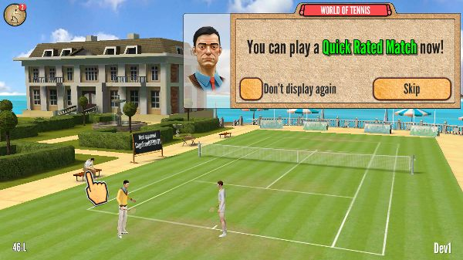
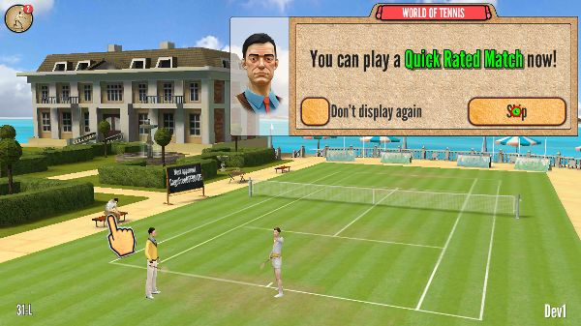
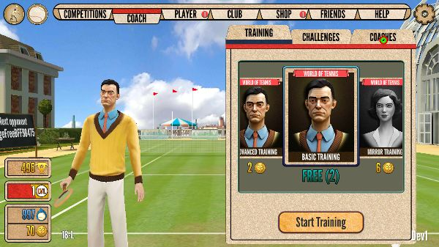
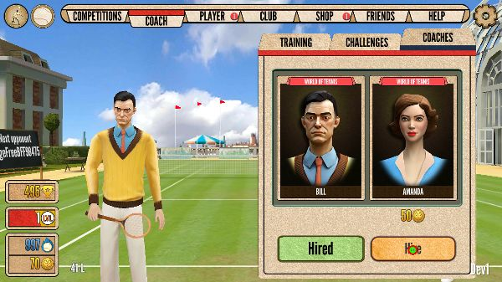
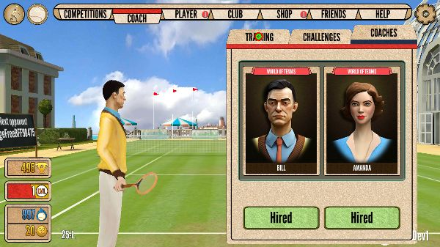
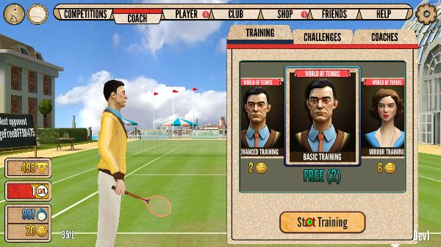
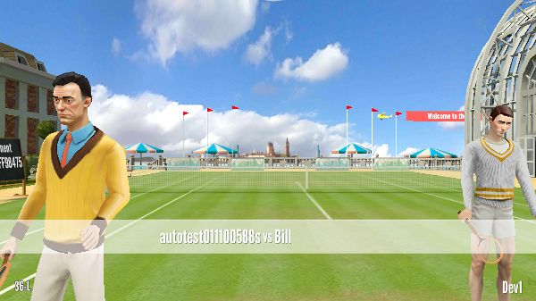
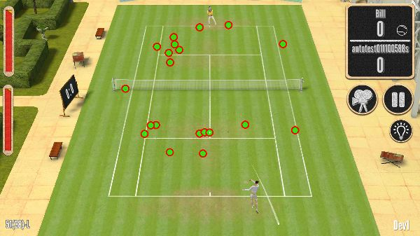
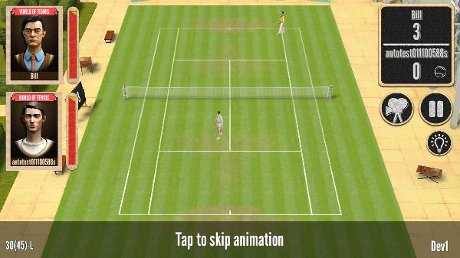
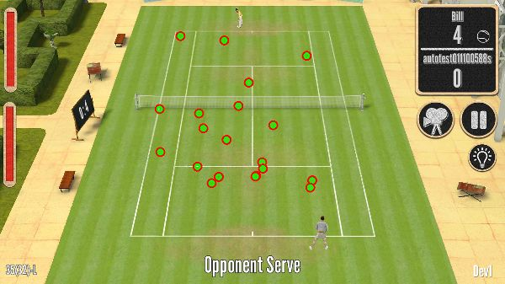
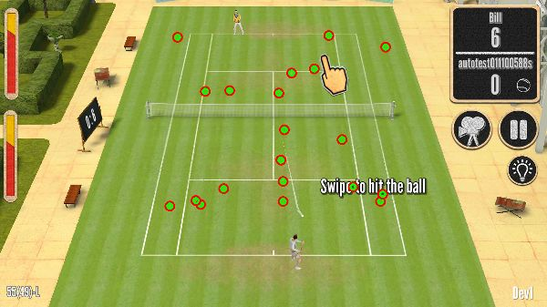
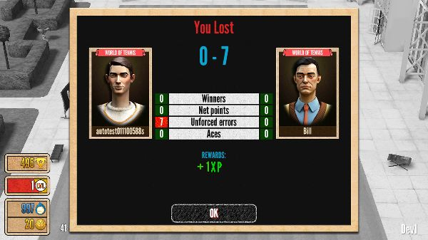
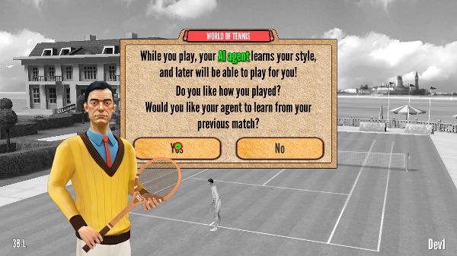
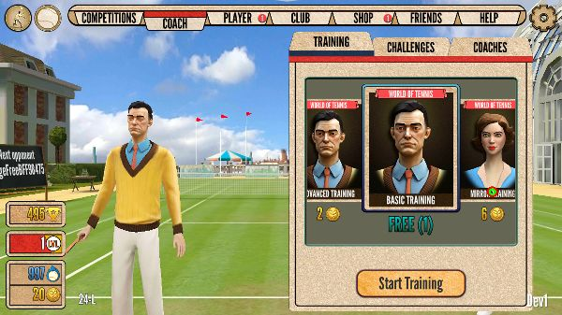
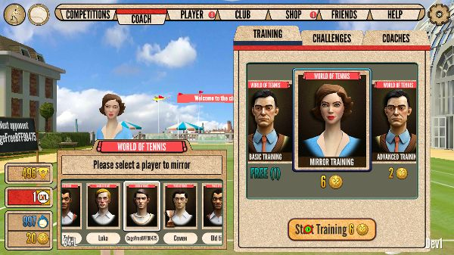
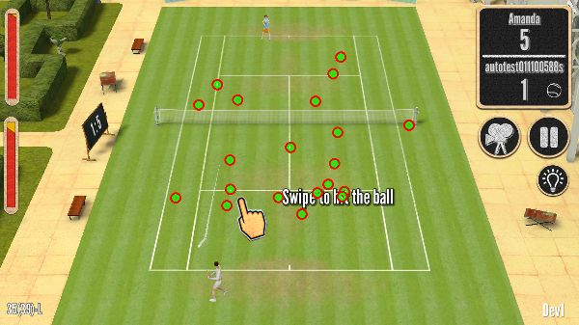
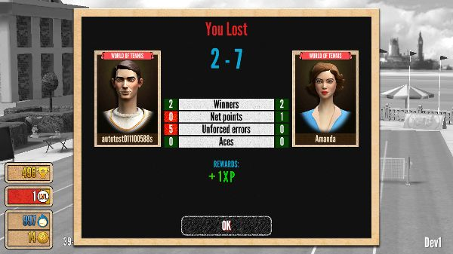
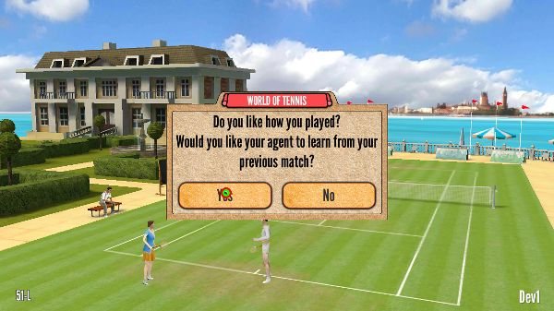
Example scenario
Other scenarios:
Pass tutorial.
Customize player, upgrade skills.
Link a Facebook account

Slide 23
Farming and scripting
How to achieve it?
You’ll need to write test scripts.
You’ll need to have a device farm for running tests.

Slide 24
The easy way
Use existing device farms offered by Amazon, Bitbar, etc.
Pros: easy setup, thousands of devices.
Cons: quite expensive (~15 USD per minute per device) (in our case it translates into ~250 USD daily), device choice is still limited.
Notes: you’ll have to rely on platform-supplied scripting (before writing scripts one must choose the platform).

Slide 25
Our way
Let’s build a device farm ourselves!

Slide 26
Own farm: pros and cons
Flexible: we can choose any devices we need.
Inexpensive (in the long run).
Limited to few specific devices.
Requires regular maintenance.

Slide 27
Minimal setup
Logically, there are three components involved:
A device executing the test scripts (runner).
A device interfacing with the target platform (server).
A target device running our game.
target device
test runner
test server

Slide 28
Minimal setup
For the Windows/Mac target platform all three components can be located on the same physical machine.
For iOS/Android at least one desktop and one mobile device is required.
iOS devices can be handled only by Mac-based test servers.

Slide 29
Software setup
Testing capabilities are available on all major platforms. No software is necessary, but some configuration is required.
Android/iOS/ Win/Mac

Slide 30
Software setup
Test server must run a 3rd-party testing framework. We chose open-source Appium (https://appium.io).
Android/iOS/ Win/Mac
Appium

Slide 31
Software setup
Test runner executes scripts written using a conventional programming language supported by the framework.
Python + Appium libs
Android/iOS/ Win/Mac
Appium

Slide 32
How test scripts look like?
Technically, they consist of code like this:
e = appium.find_element_by_class_name('android.widget.EditText')
e.send_keys("hello") # type “hello” into the EditText control
ok = appium.find_element_by_class_name('android.widget.Button')
ok.click() # click the first button on the screen

Slide 33
How test scripts look like?
In our game most GUI elements are drawn on the screen surface and thus not considered “UI” by the operating system.
Thus, we use image recognition:
ib_loc = find_image("input_box.png") # fail test if not found
click_location(ib_loc)
ok_loc = find_image("ok_button.png") # fail test if not found
click_location(ok_loc)

Slide 34
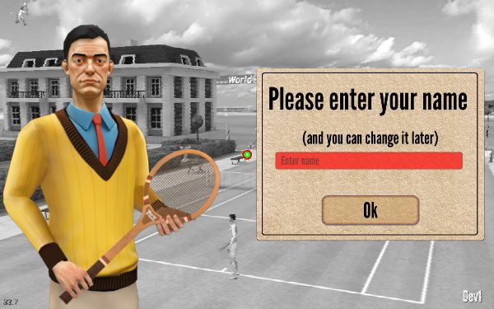
How test scripts look like?
input_box.png
ok_button.png

Slide 35
How test scripts look like?
Our test scripts are integrated into the whole build process:
A test script checks whether a new build is available.
If yes, this version is tested with a set of scenarios.
Results are summarized and published as an HTML report.
The process is repeated.
HTML reports are used by the testers to check visual glitches and understand why certain tests fail.

Slide 36
Our pipeline
Build machine
Ready game
Repository
Test scripts
HTML reports

Slide 37
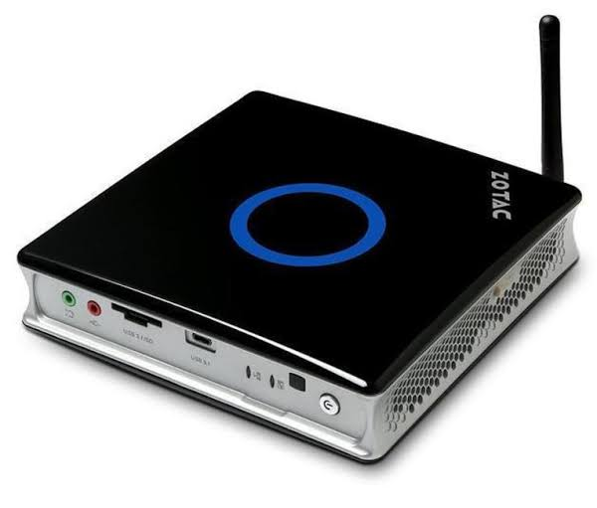
Complete hardware setup
Test server 1:
Zotac ZBox E (Windows)
3 Android devices
Test runner:
Zotac ZBox MI (Windows)
3 iOS devices
Test server 2:
Mac Mini

Slide 38
Complete hardware setup
Servers
Mobile devices

Slide 39
Tips, tricks, and notes
Farming isn’t easy!
There are numerous pitfalls…

Slide 40
Choosing test devices
When choosing devices, we tried to focus on hardware diversity and get some low-level models.
Sometimes code fails on certain hardware (it happens, e.g., on different GPU chips)
Developers usually have reasonable hardware, so autotests help to make sure the game is still runs smoothly on low-end devices.

Slide 41
Current farm setup
Android:
Doogee X5 MaxPro: a cheap low-end phone.
Kindle Fire 5th Gen: a tablet.
Xiaomi Redmi Note 3 pro: a typical mid-range device.
iOS:
iPad Air, iPhone 5s, iPad Mini 2: diverse Apple devices including low-end models.

Slide 42
Choosing a USB hub
Mobile devices are connected to a server via USB hubs.
Devices should get power through the hubs (otherwise they will simply discharge).
Surprisingly, it is very difficult to find a hub, able to charge several attached devices fast enough!

Slide 43
Choosing a USB hub
Amazon description and reviews can be deceptive!
!!!

Slide 44
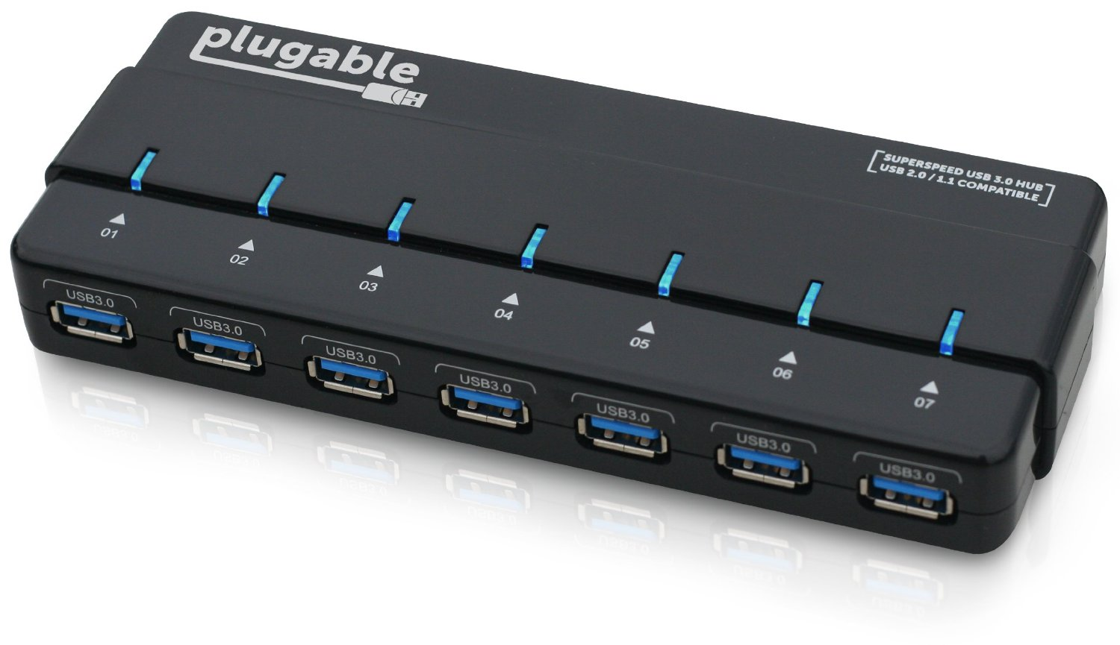
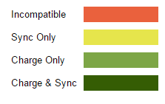
Choosing a USB hub
Even good hubs can be incompatible with some devices

Slide 45
Quirks of particular devices
On Nexus 7 sometimes 2-3 attempts are necessary to install the application: it is a norm to get an INSTALL_FAILED_INVALID_URI error with no reason.

Slide 46
Quirks of particular devices
On Xiaomi Redmi Note 3 Pro after a number of install / uninstall cycles you’ll get a “no storage memory left” error (a reboot or a special cleaning ADB command helps)

Slide 47
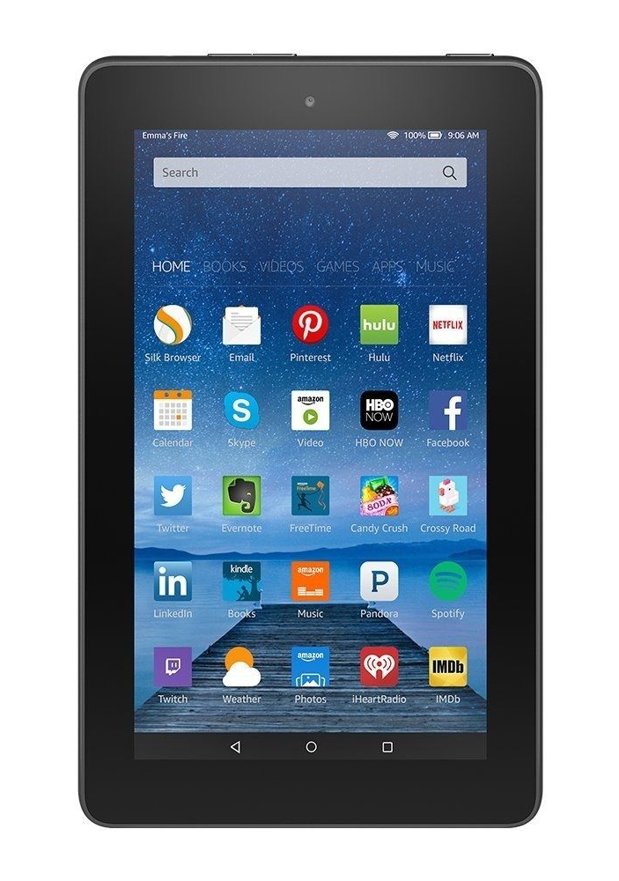
Quirks of particular devices
Kindle Fire (5th Gen) will sometimes refuse to unlock the screen to run tests
(fixed by installing CyanogenMod)

Slide 48
Quirks of particular devices
iPad 3 will not charge fast enough and will end up with an empty battery,

Slide 49
Quirks of particular devices
Samsung Galaxy Tab E will not charge at all from anything but a wall charger.

Slide 50
Quirks of particular devices
All iOS devices will ask to be updated once in a while, and that popup dialog will block all Appium requests.
You’ll have to update them or block update-checking functionality (it is not easy but possible to do).

Slide 51
It is still worth the effort
The safety net feeling we have now brought peace to our lives

Slide 52
Thanks!
[1] A. Moscaritolo (2017). Google Play Now Favoring 'High-Quality Apps’. PC Magazine, https://www.pcmag.com/news/355375/google-play-now-favoring-high-quality-apps
[2] H. Khalid et al. (2015) What Do Mobile App Users Complain About? Software, vol. 32, pp. 70-77 [3] S. Sanderson (2009). Selective Unit Testing – Costs and Benefits. https://blog.stevensanderson.com/2009/11/04/selective-unit-testing-costs-and-benefits/
Contact me: mozgovoy@u-aizu.ac.jp

