Slide 1
AI at Heart: Experiences of a Mobile Game Developer
🎮
Maxim Mozgovoy
The University of Aizu (Japan) & Helium9 Games
https://mmozgovoy.dev
Notes:
“Homecoming” to Game-On (2015)
Wrap up, retrospective.

Slide 2
Hello!
I work at the University of Aizu, Japan. I am also a co-founder of Helium9 Games.
My primary area is human-like AI for computer games and simulations.
I also do some work in gamification of second language acquisition.
Notes:
Just some quick info.
Maybe note my last year keynote.

Slide 3
The Beginning
Yet Another Indie Game Project (with a twist)
Notes:
For IU: from high-profile projects to own business
For MM: doing something practical and fun.

Slide 4
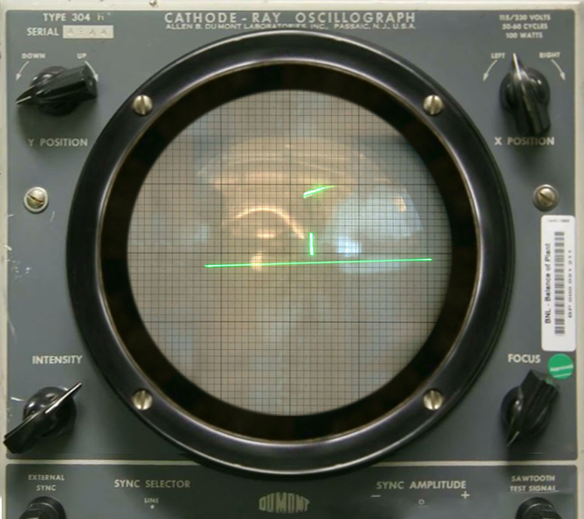
Initiating a game project
TENNIS!
What is doable?
Money
Time
Complexity
What is not too risky?
“Safer” genres in terms of audience and competition
Easier discoverability (keywords)
Fewer debate-raising elements
How to stand out? (Twist)
^{¯\_(ツ)_/¯}
Tennis for Two (1958)
Notes:
The starting point.
Building a sustainable business.
Have some initial funding, but probably no second chance.
Building from ground rather than making a moonshot.
Should not fail miserably.
“Candy crush saga” – how to discover?

Slide 5
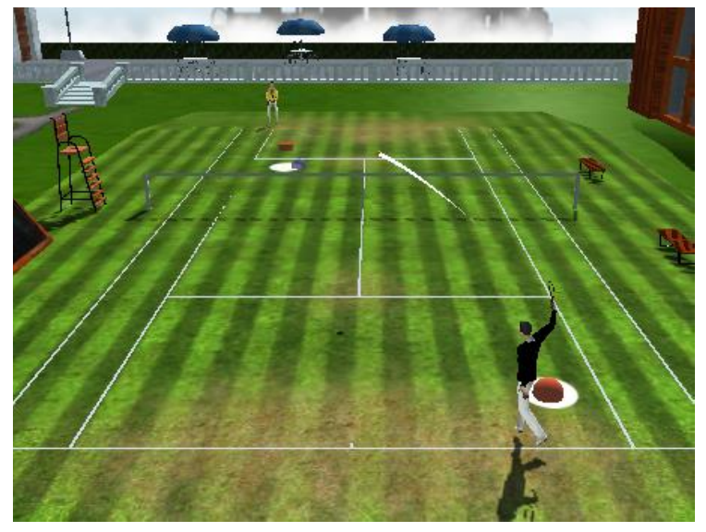
Stand out vs. Go with the crowd
Go with the crowd:
Basic gameplay (tennis…)
Metagame / Character progression
Monetization (F2P, long term play)
Stand out:
Stylish '20s environment.
More tactical / less arcade.
Trainable AI bots.
Developing trainable bots for a mobile game of tennis (Game-On, 2015)
Notes:
Things where we are “sort of experts”
Things we don’t understand, and the cost of error is high.

Slide 6
Trainable bots: motivation
Back in 2015 we considered AI the single most important “gimmick”
(other elements just “had to be there” in any case)
Tennis is a relatively simple game. How to retain users?
Numerous opponents, diverse in their skills and behavior.
Tennis is a fast game. What to do with multiplayer mode?
Lags/slowdowns are a problem.
Matchmaking is a problem. (Same region / same skills).
How about trainable bots?
We’ll learn play styles of our users and turn them into opponents!
Notes:
How to get many opps with low user base?

Slide 7
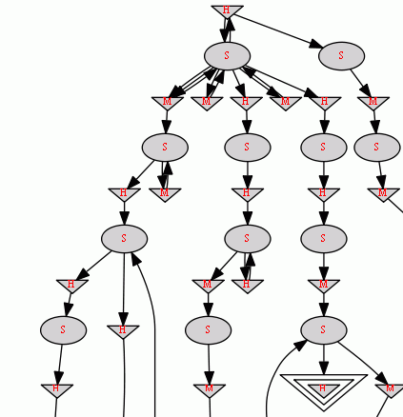
Under the hood
In terms of ML architecture, our AI is quite traditional:
Hierarchical Markov decision processes for knowledge representation.
Handcrafted set of features.
Few additional heuristics / hacks.
Behavior of a player can be learned reliably after 10-15 min of observation.

Slide 8
Petty Problems
The Trifles Strike Back

Slide 9
Blurb (abridged)
Precise Swipe and touch controls.
Realistic / true motion ball and shot physics.
Lag-free asynchronous multiplayer.
Earn trophies in leagues and major tournaments.
Train your game AI character to play just like you.
Customize and develop your character.
Join private clubs, earn prizes, climb global leaderboards!
Notes:
It is (mostly) for robots!
But also shows what we can emphasize.
(And shows what other games emphasize).
Note “async MP”

Slide 10
What actually took time (after playtests)
Tweaking controls
Teaching gameplay; revising tutorial (n times)
Tweaking difficulty curve
Streamlining the game (fewer options from the start)
“Gestalt” (was it positive?..)
As a result, “train your AI” function was significantly downplayed.
There is no dedicated “train” feature anywhere.
Notes:
How to make it user end feature?

Slide 11
What actually took time (after playtests)
Tap: top side = shot, bottom side = move
Double tap: top = lob shot, bottom = quick move
Ball receive is automated
Notes:
Just one of the examples (related to core gameplay).
What means “tactical” vs “arcade”
Remove elements with no freedom of choice / pure reflexes. (like run and hit)

Slide 12
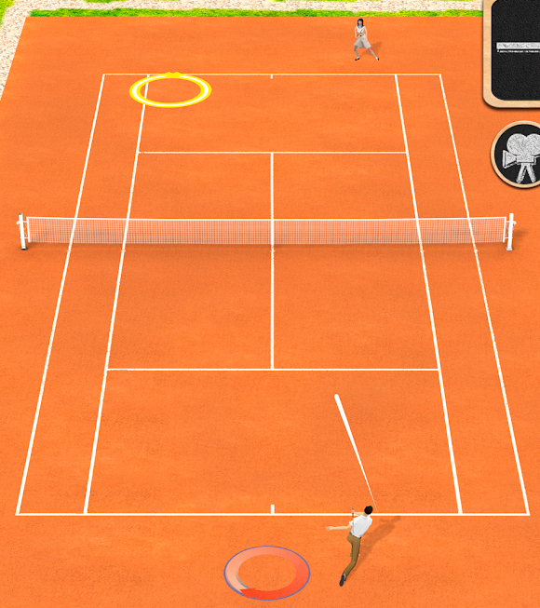
What actually took time (after playtests)
Tap: top side = shot, bottom side = move
Double tap: top = lob shot, bottom = quick move
Ball receive is automated
Notes:
Why tap-tap-tap?

Slide 13
Launch and After Launch
AI makes its comeback as a (hidden) understructure

Slide 14
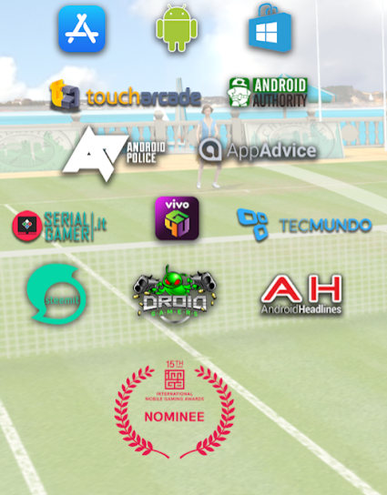
“If you don't blow your own horn, no one will do it for you”
Website: www.worldoftennis.com
Got featured by Google Play, Appstore, became Game of the Day
Got reviews in press, YouTube, etc.
Around 14 000 reviews on Google Play, 4.3⬇, approaching 1 mln downloads
In general, it is within ≈ top 5 tennis games (depending on region & platform)
Notes:
In terms of money, the curve is very steep! So “top 5” is much worse than “top 2”, e.g., that’s why people fight for ASO.

Slide 15
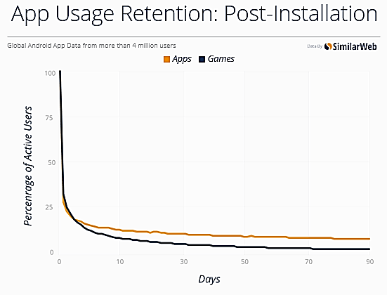
Post-Release Tweaking
Words I had to hear way too often:
Retention! Monetization!
App store optimization!
Activities:
Tweaking app store texts
Improving day 1 retention.
Tweaking products & prices
Notes:
“Day 1” is one of the keys (retention stabilizes at some point).

Slide 16
Post-Release Tweaking
How to find out why people leave?
Read reviews and understand their real meaning.
Guess and experiment.
The only solid knowledge comes from playtesting.
“It's a bit rigged in its play as if you dont buy to go up, it gives you the negative responses. Like most games its about the money. I just play you know when your player is going to lose no matter how you play! It's not always the skill factor. . Not rigged ???” – Google Play
Notes:
It would have been SO much easier without F2P!
Also:
Only people who play write reviews.
You never know why people who leave early leave.
Reviews often write unhappy users.
Sometimes they come up with very complex and creative explanations!

Slide 17
Controls, Multiplayer, Difficulty
Controls
“Unconventional” stuff works bad.
E.g., we had to replace “hit early” with “hit on time”.
It seems that some gestures are inherently satisfying (like swipe in sync with racket).
Notes:
Areas to improve or dumb down?

Slide 18
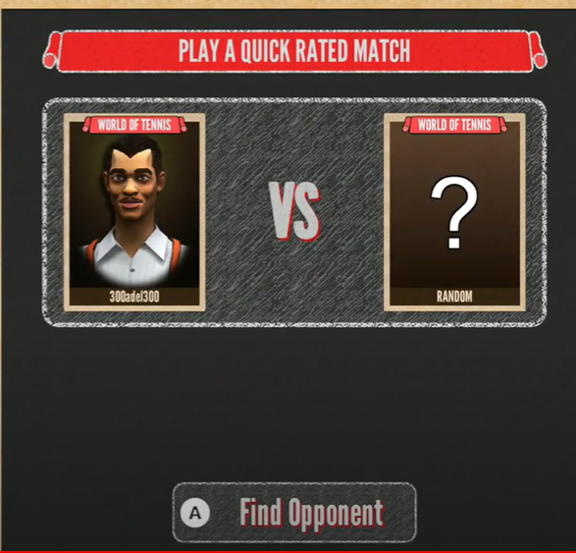
Controls, Multiplayer, Difficulty
Multiplayer
People demanded it!
When we added a “vs random opponent” game mode and removed the pause button, people stopped demanding…
Notes:
One of darker patterns (maybe the only dark). Still, many other games use it (like Just Dance 20xx on Wii)

Slide 19
Controls, Multiplayer, Difficulty
Difficulty
People complained saying that “the game is rigged”, “controls are broken”, “you are forced to pay”.
When we made sure that 2/3 of the opponents in the player’s league are weaker than the player, complaints were mostly gone…

Slide 20
The Place of AI
AI is a crucial component in these tweaks
Everyone wants to win most matches
In real multiplayer, 50% of players won’t be happy…
Many want to play against people (with instant matchmaking and zero ping)
Notes:
This is ‘fantasy sport’: even in games like FIFA, there is little realism. You can score twice in 15 mins, while in reality you can have 0:0 after 90 mins!
Remember Flow: the player must feel the sense of progress (in reality a team can be stuck in the middle of the league forever)

Slide 21
Evolution of Our AI Development
Earlier Phase
Make sure it mimics players well
Make sure it is as strong as the original player
Tweak to avoid learning obviously poor behavior
Think how to use “train your AI” capability
Later Phase
Focus on having a large set of AI characters to choose from
Understand AI level to use in matchmaking

Slide 22
End Notes
AI can be a major or pivotal technology in your game.
Though it being at a forefront is unlikely.
Think where AI can make a difference (which functionality cannot exist without AI?)
Think of features the given AI possesses
“…games are about creating a particular experience for the player—whatever that experience may be. The purpose of Game AI… is to support that experience” (Kevin Dill)
Notes:
Exceptions do exist…
Prop vs central technology (soccer? Can’t control all 11 players), “just have to be there”
(contrast with tennis)
“Features” (predictability / unpredictability / adaptability / robustness / etc.)

Slide 23
Thanks!
Questions are welcome
Maxim Mozgovoy
The University of Aizu, Japan Helium9 Games mozgovoy@u-aizu.ac.jp
Slide template by www.slidescarnival.com

